Slide 1
Ride for Kids Logistics Meeting

Slide 2
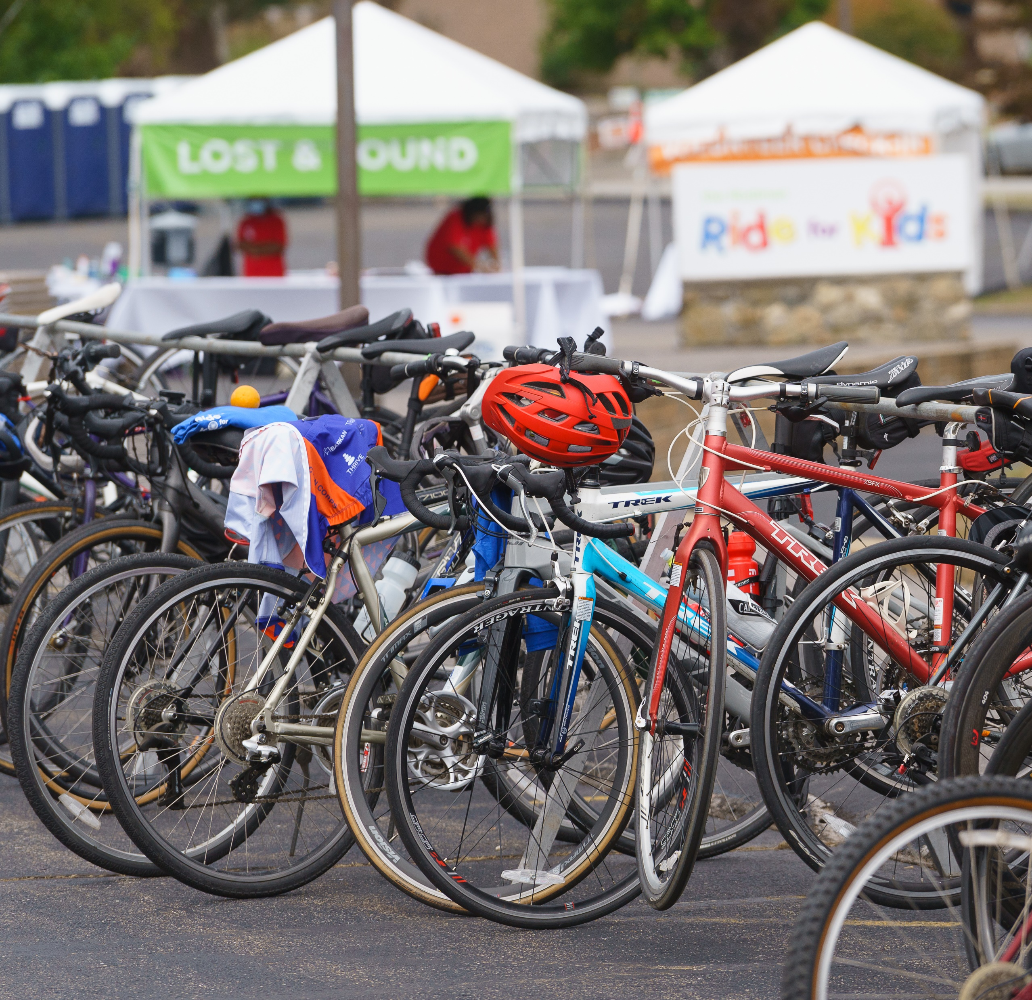
The Road Ahead…
Welcome
Purpose of meeting: detailed logistics overview
Please hold questions until the end
Stick to relevant questions for all
Stay on after call for org-specific questions or call us

Slide 3
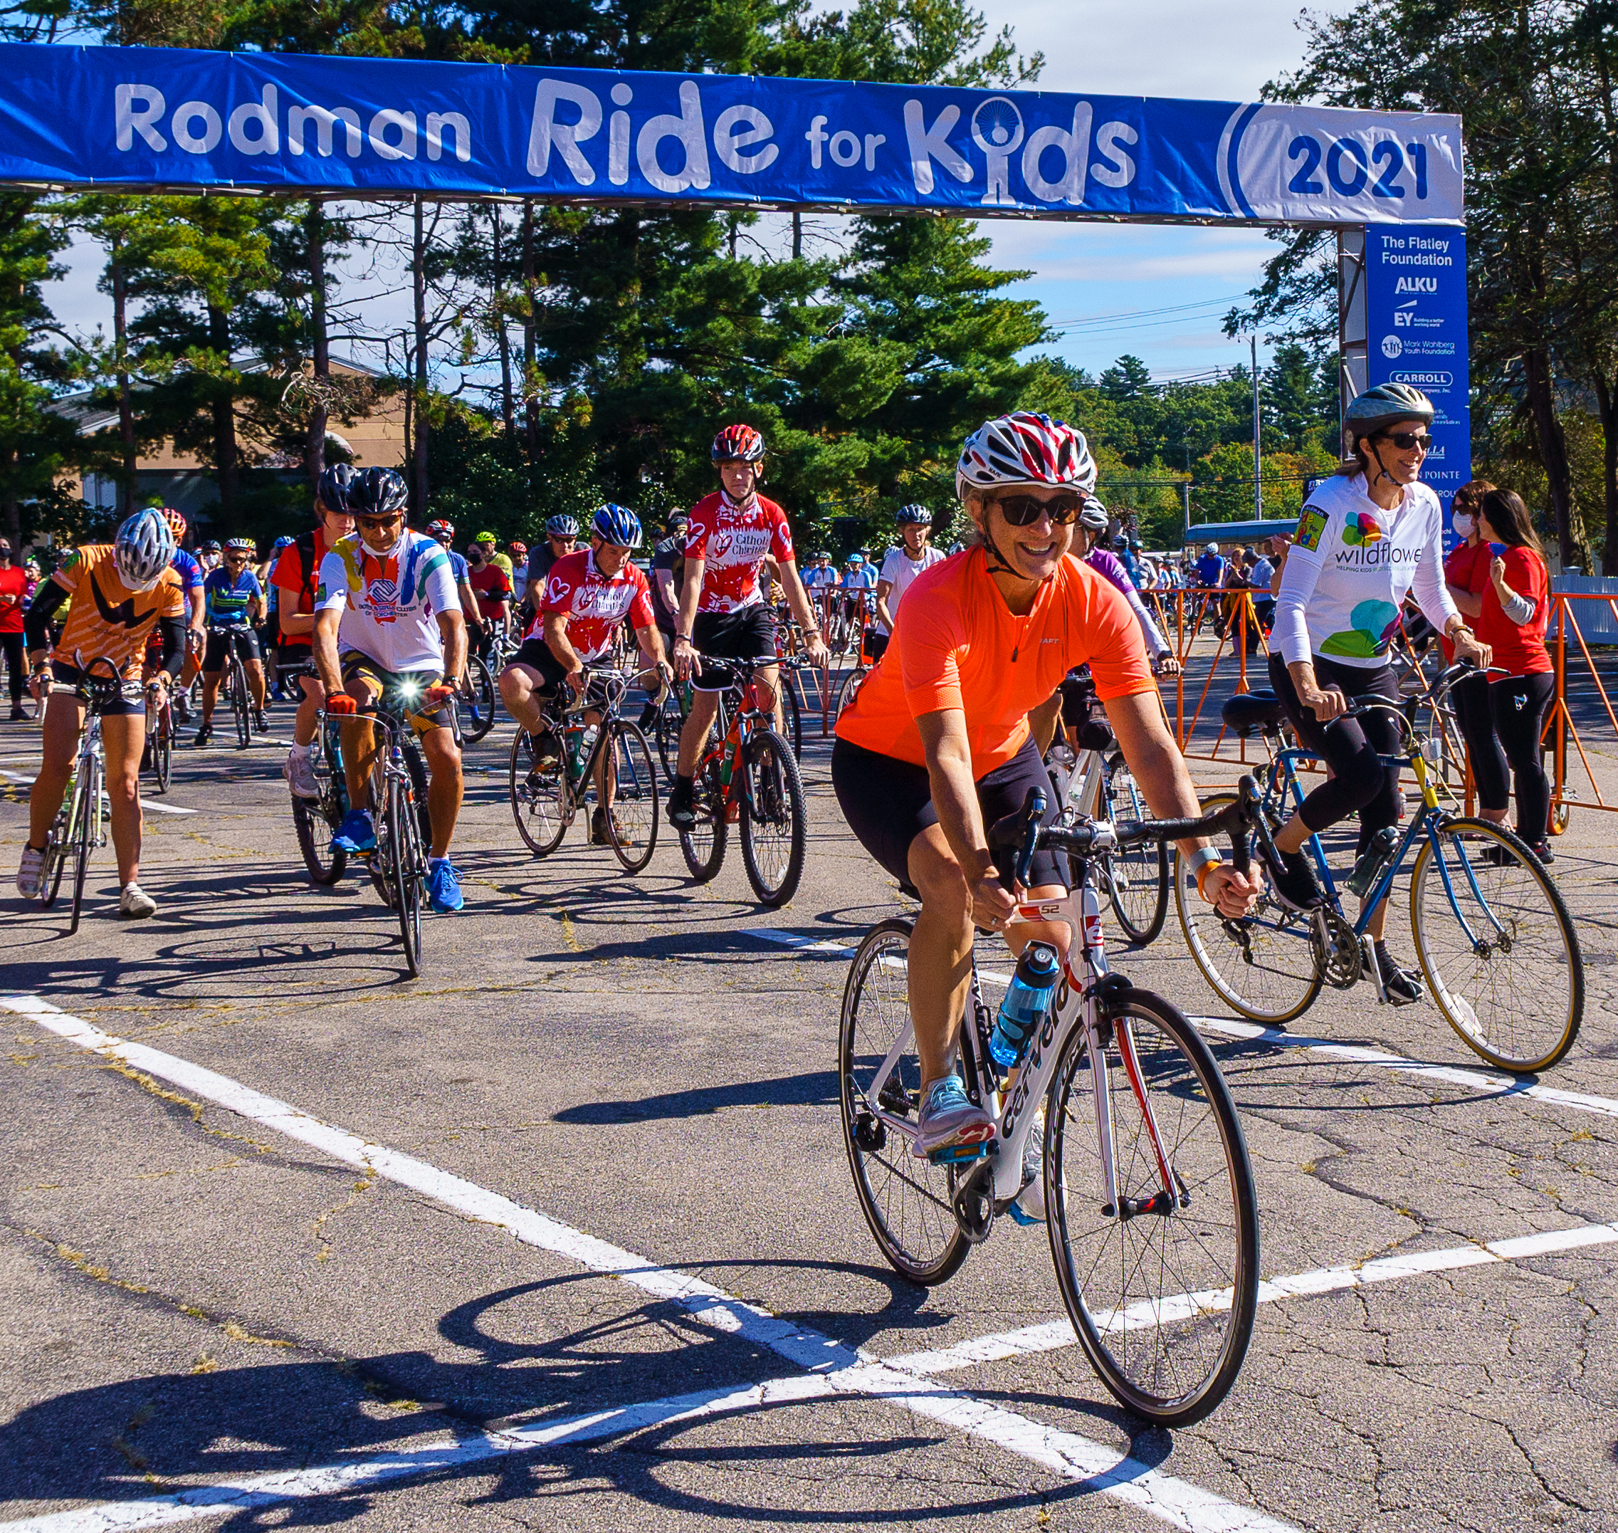
The Road Ahead…
Status: Riders
Current numbers
319 25-milers
195 50-milers
688 Choose Your Own Adventure
Based on bib requests, we were expecting 650-700 riders
If you have participants changing from CYOA to rider or vice versa, please make changes by Monday.
Check riders’ emergency contacts
CYOA bibs mailed on 9/8

Slide 4
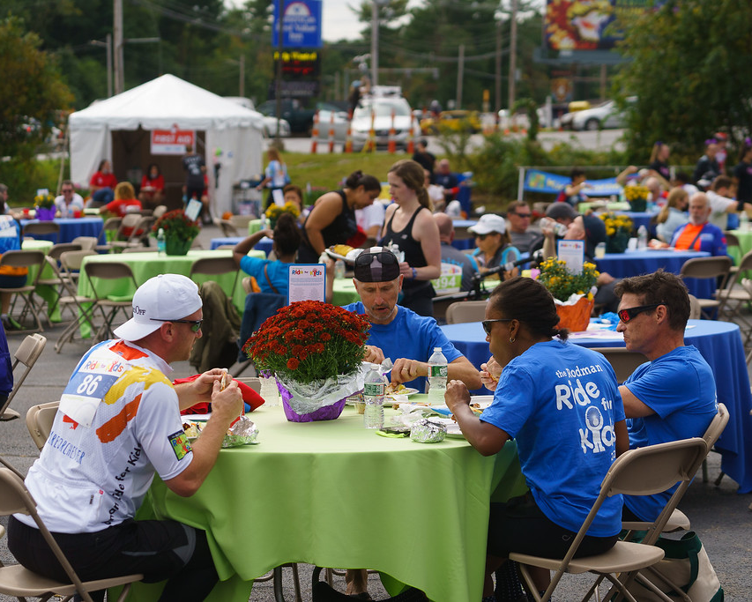
The Road Ahead…
Status: Volunteers
Areas we still need help: BBQ, Spotters, Finish Line Cheering – 50 spots to fill in total
All Partners required to have 6 volunteers
Please communicate with Jess if you haven’t sent your sheets yet.

Slide 5
The Road Ahead…
Status: Fundraising
2022 YTD: just over $1 million
Please be sure to enter offline gifts
Will follow up with those who are significantly behind from last year.
Fundraising Deadline is 11/1

Slide 6
The Road Ahead…
New Site!
38 Neponset Avenue, Foxboro

Slide 7
The Road Ahead…
New Site

Slide 8
The Road Ahead…
New Site

Slide 9
The Road Ahead…
On the Route
Start Line – Ed Kelley, Antoinette Antonio, Lauren Baker, Noa
50-mile start at 9:00 AM
25-mile start at 10:15 AM
Cue sheets and links to MapMyRide on website
Lost & Found located at Welcome Tent
Support
Safety presentation at Start Line
24 Police Details along the route
12+ spotters
Medics at Start/Finish Line and all Water Stops
11 Road Crew vehicles each with a team of 2 volunteers
Communications Team
Mechanics
3 Water Stops (1 for 25-mile)

Slide 10
The Road Ahead…
Safety
There will be a Safety Presentation at Start Line
Key rules:
Follow the green arrows, look for the confirm arrow
Helmets required, earbuds/headphones not allowed
Bib must be visible on back, out layer at all times
No children under 12; 13-17 discouraged but allowed with an adult & signed waiver
Riders should always ride in single file, and obey traffic laws and cycling etiquette
Route supported until 3pm

Slide 11
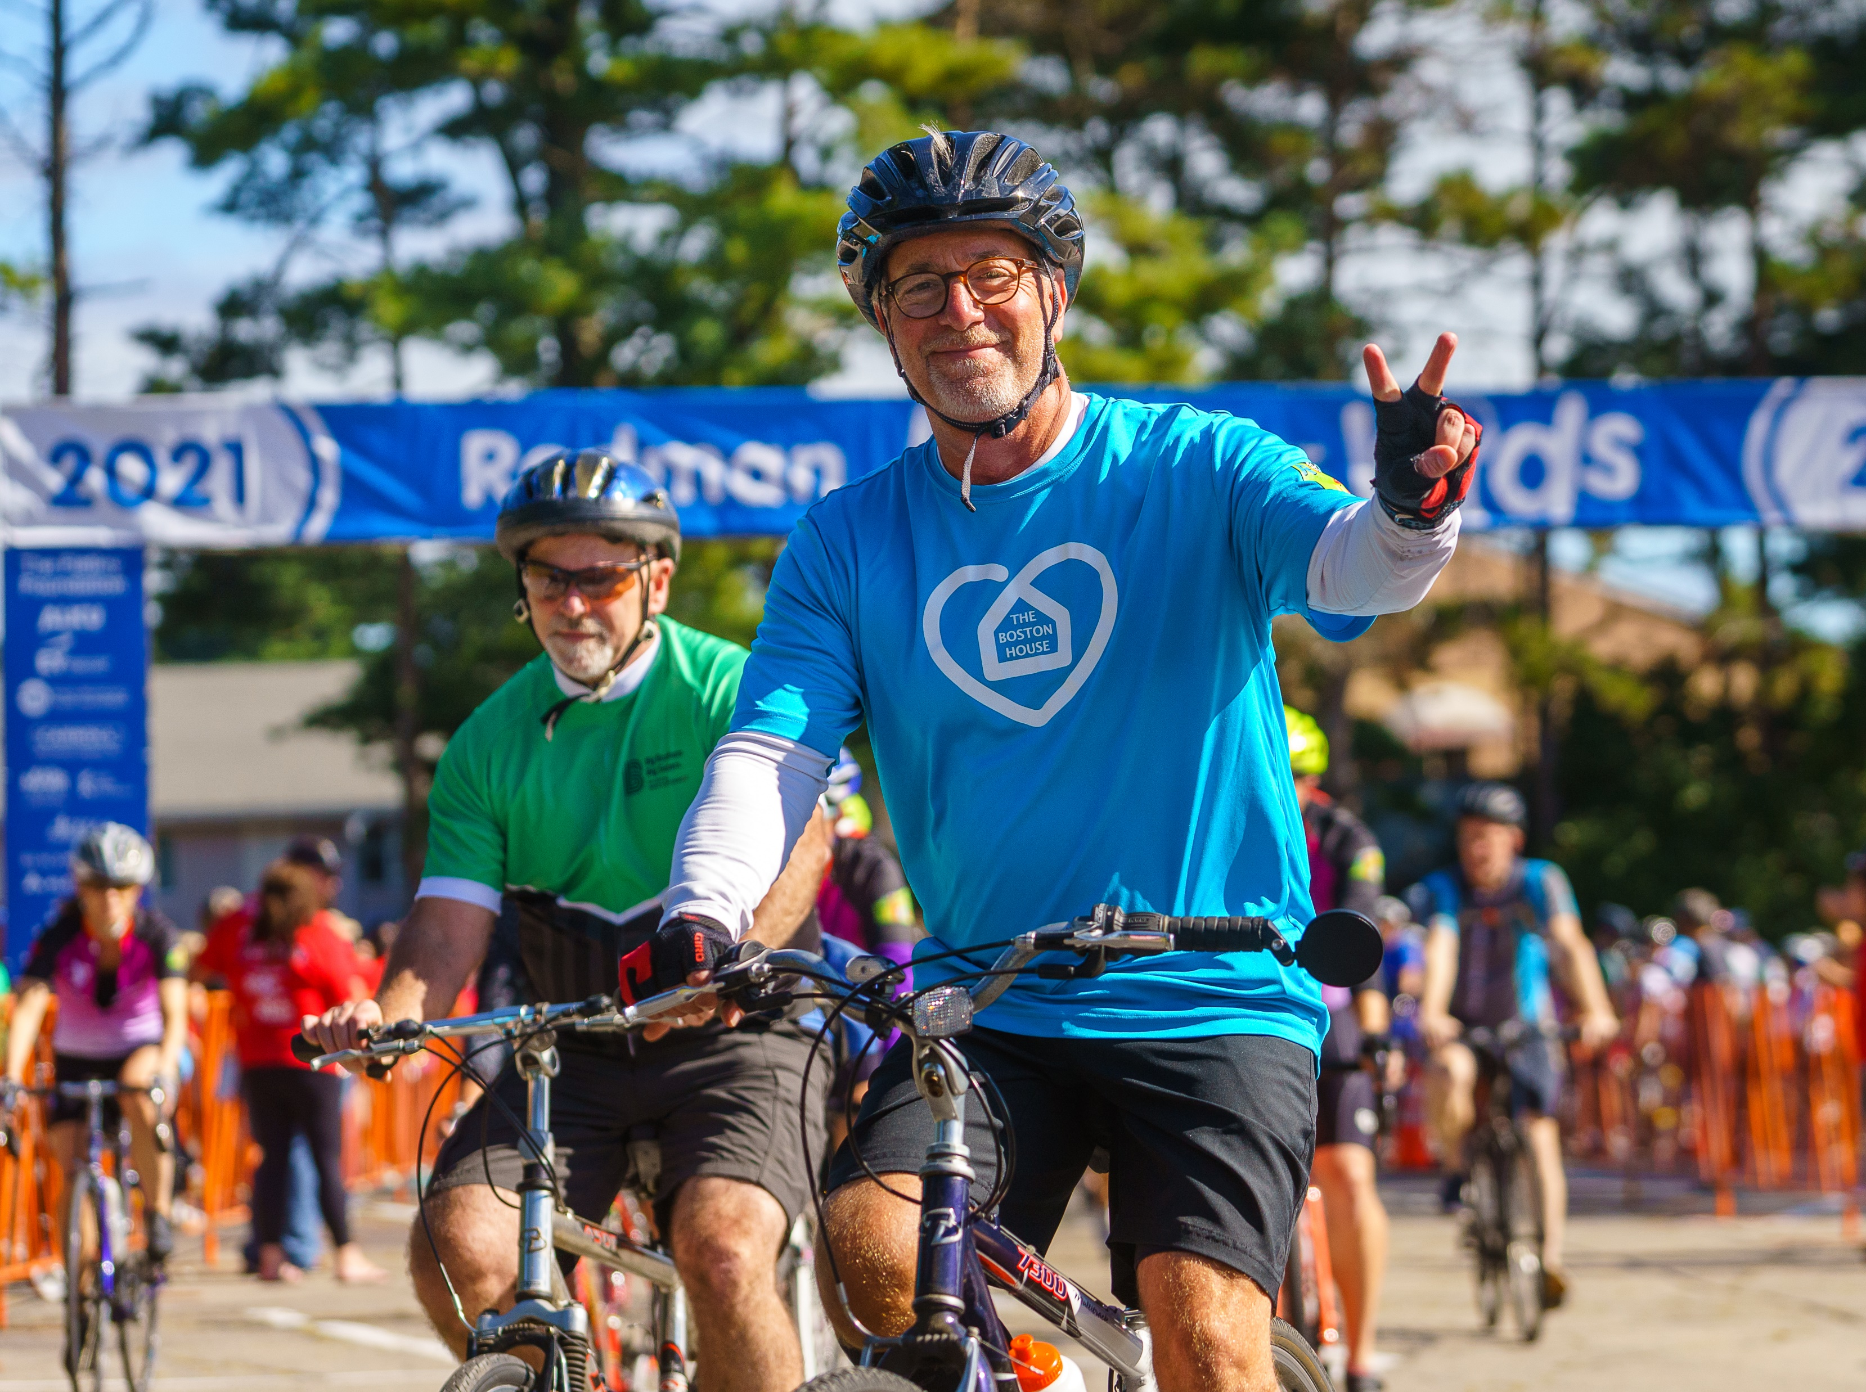
The Road Ahead…
Riders
Arrive 30 min. before start time
Info email for Riders including parking permit sent to Partners immediately after meeting

Slide 12
The Road Ahead…
Friday Set Up
40-50 volunteers will be on site
This information does not apply to Road Crew
Friday Volunteers – where to go
Park in VIP lot adjacent to main site – use 11 Neponset Ave. in navigation
Report to BBQ tent for 10AM
Breakfast & lunch will be provided
Dress comfortably and be prepared to be outside all day (regardless of weather)

Slide 13
The Road Ahead…
Friday Set Up
Each volunteer will be assigned to a group
Tasks include
Folding & organizing Rider & Volunteer shirts
Assembling spotter goody bags
Assembling registration packets
Setting up breakfast & BBQ tents
Setting up tables, chairs, and signs
Plan to be here until 3PM (hopefully we will wrap up sooner)

Slide 14
The Road Ahead…
Saturday Volunteers
Arrive 20 minutes before shift, check in at Volunteer Check In tent
Dress for weather & being on feet
Volunteers should check in with Captain upon arriving at station
HQ Spotters
Will receive VIP permit
Volunteer tent will give them shirt and address to report to with instructions for parking
Will drive their own vehicle out
Don’t leave until shift ends or Road Crew gives go ahead
Info email for Volunteers including parking permit sent to Partners immediately after meeting.
Our team will contact Volunteer Captains for check-ins early next week

Slide 15
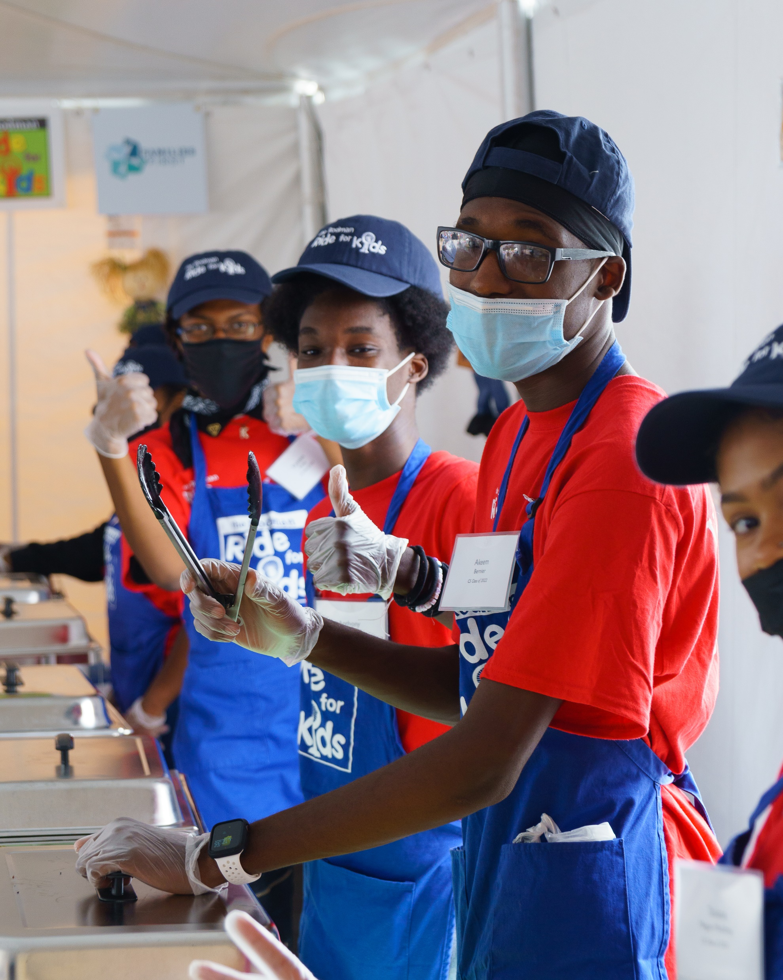
The Road Ahead…
Saturday – Food & Beverage
Breakfast provided by Honey Dew
BBQ lunch
Water Stops
Beverages: Soda, water, beer, wine, & hard seltzer

Slide 16
The Road Ahead…
Saturday – Warehouse
Warehouse is set up in 5 PODS behind BBQ tent
Accessible from a driveway entrance on far side of lot
Water Stops will pick up supplies at the PODS Friday between 2-5PM
Radios will be picked up at Communications by Start Line

Slide 17
The Road Ahead…
Partner Meeting Tables
Morning use only
Purpose: Give you designated spot to meet riders, hand out jerseys, etc.
8’ table with provided linen
Alphabetical order
Table and chairs must be broken down and stacked in a TBD location at end of shift.
Please enter a Yes or No and your org name in the chat so we’ll know if you want a table.

Slide 18
The Road Ahead…
Rider & Volunteer Emails
As mentioned, detailed Rider and Volunteer emails will be going out to you today.
Be sure to circulate them to all Riders and Volunteers by tomorrow and include your org-specific information (ie: meeting table).
Especially important this year because of the new location!
We don’t send these emails as they are more likely to be opened if they come from you.
All of this information is also on our website.

Slide 19
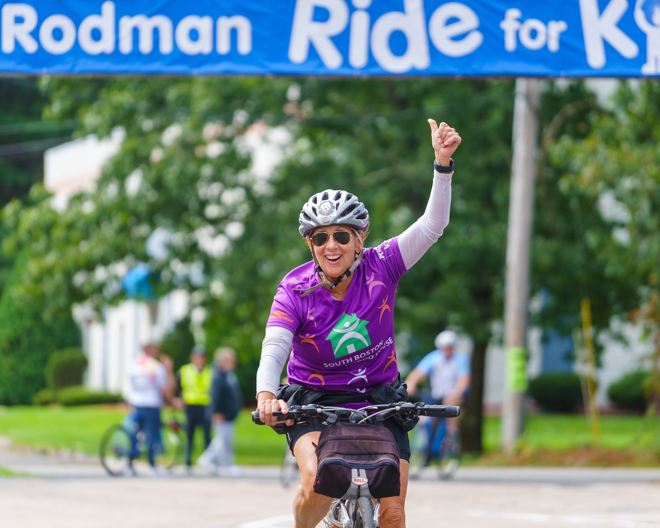
The Road Ahead…
Final Info & Reminders
Foul Weather Plan
Changes from Rider to CYOA or vice-versa in Donor Drive ASAP.
Volunteer Sheets to Jess today
Logistics Manual

Slide 20
Ride for Kids Logistics Meeting

